Slide 1
Mid Bootcamp Project Bank Analysis
Gustavo Barros

Slide 2
Objectives
Analyse the bank’s customers and build a Machine Learning model to predict if the customer would accept a credit card offer;
Create a dashboard with useful KPIs to track the sales team performance and identify areas of improvement

Slide 3
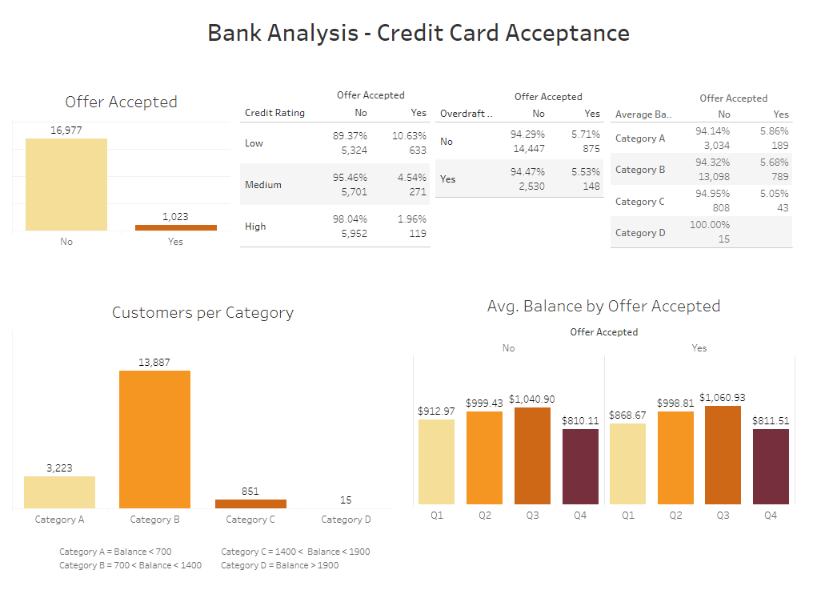
Customers analysis
Tableau Dashboard

Slide 4
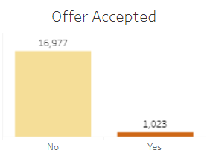
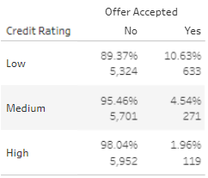
Customers analysis
Offer Accepted = 5.68%
Low Credit Rating = High Offer Acceptance

Slide 5
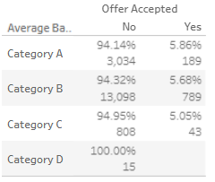
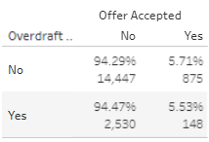
Customers analysis
To whom we should make an offer?

Slide 6
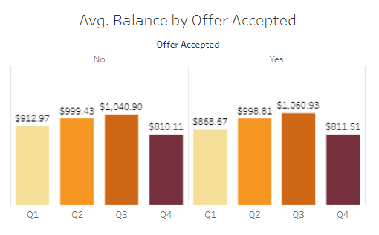
Customers analysis
When is the best time to make the offer?

Slide 7
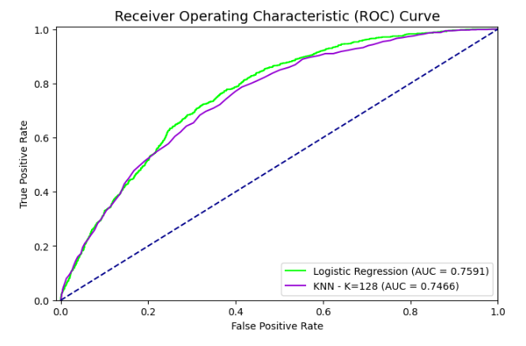
Machine Learning Models
Logistic Regression
Acc. Score = 0.6985
ROC-AUC = 0.7591
KNN
Acc. Score = 0.6857
ROC-AUC = 0.7466

Slide 8
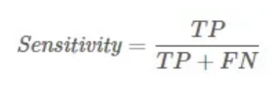
Machine Learning Models
Logistic Regression
Sensitiviity = 0.7153
KNN
Sensitiviity = 0.7706
Notes:
Sensitivity or recall is important when you are concerned with identifying positive outcomes and the cost of a false positive is low

Slide 9
Machine Learning Models
KNN!

Slide 10
Areas of improvement
Chi² contingency test for categorical features
Find the best threshold for the models

Slide 11
Thank you!
github.com/gustavossbarros

